Slide 1


The National Recovery and Resilience Plan (NRRP) funded climate-controlled research greenhouse with phenotyping system and sequencing laboratory.
This new infrastructure will drive deep, high-resolution investigations into the precise role of potato plant responses to environmental stresses.
Plant Breeding and Acclimatization Institute – National Research Institute
¹ Bonin Division,76-009 Bonin POLAND

Slide 2
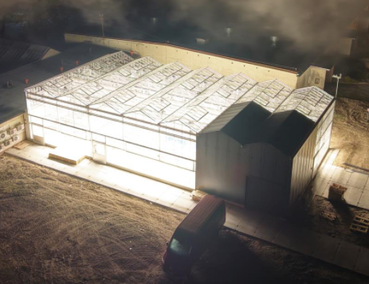

Slide 3
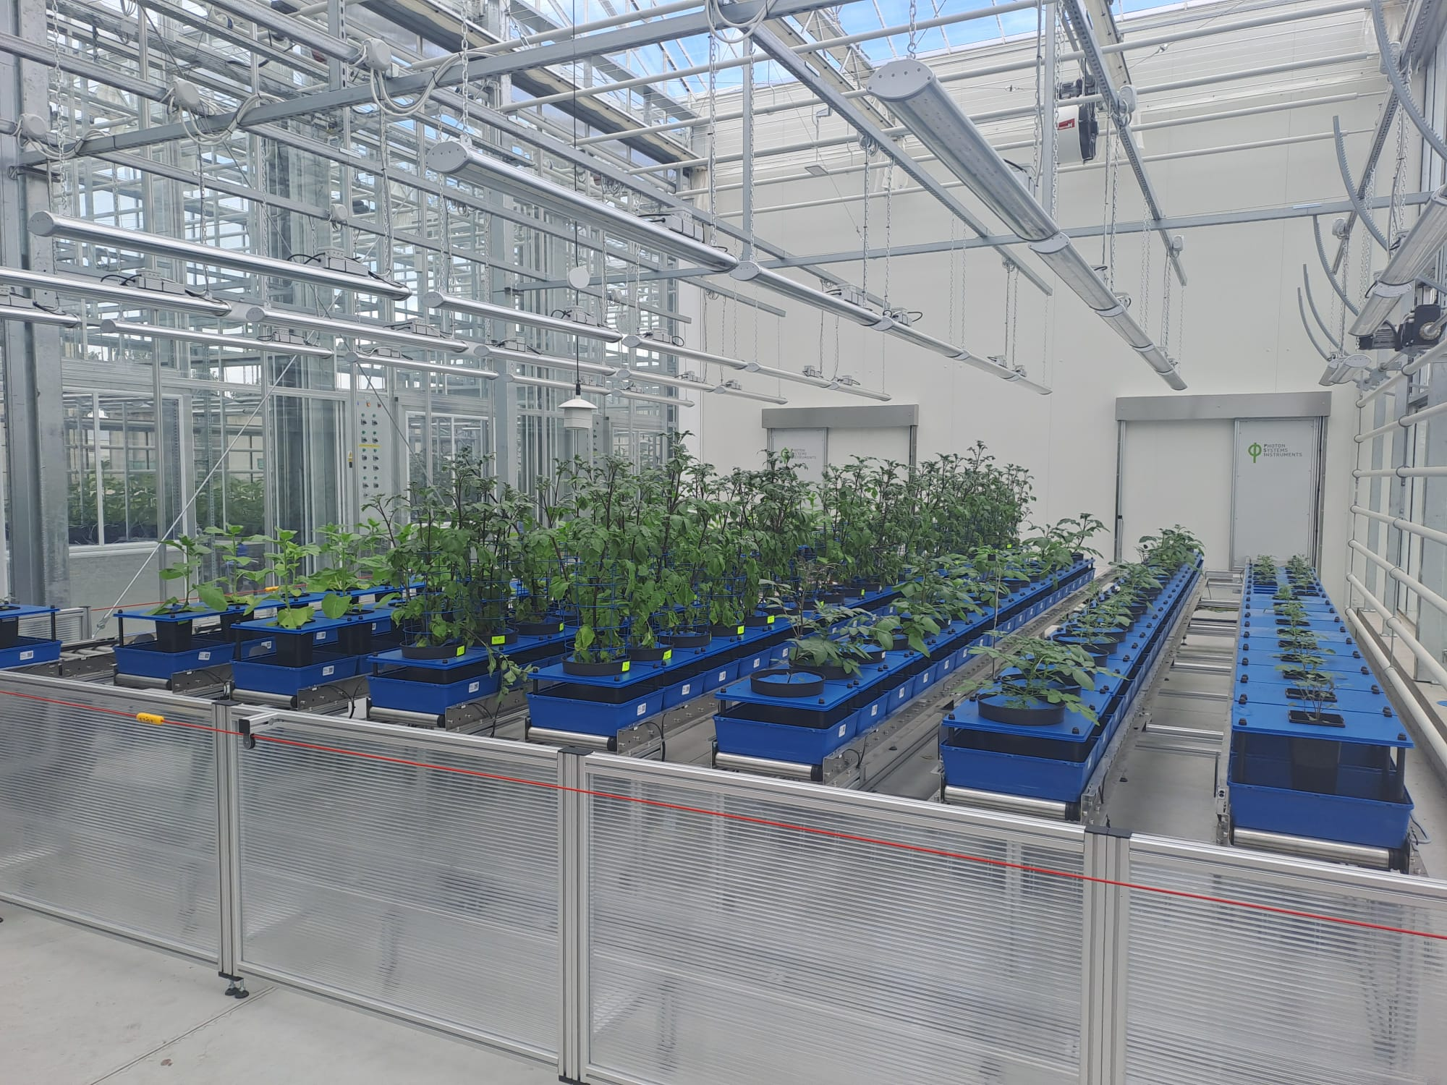
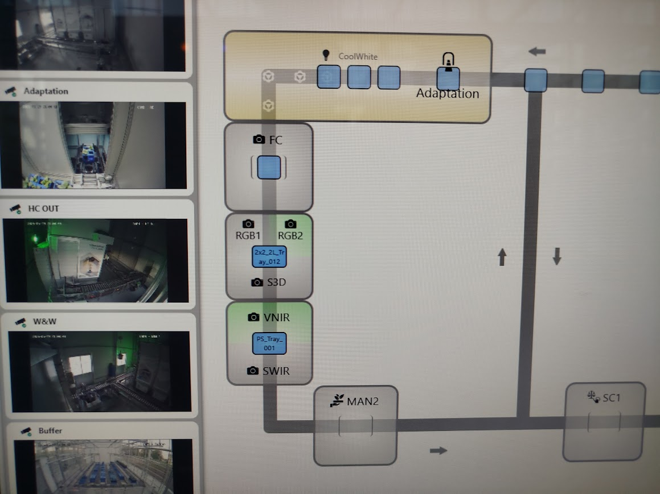

Slide 4

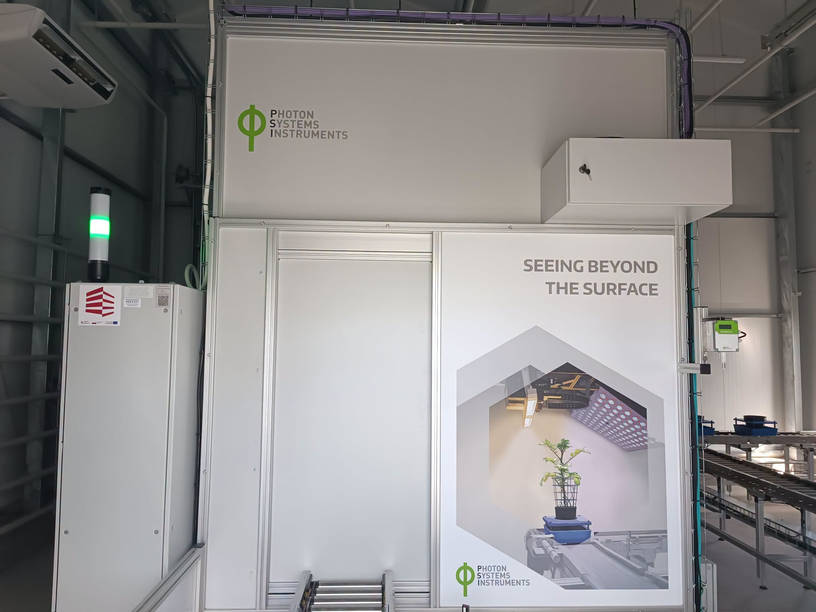
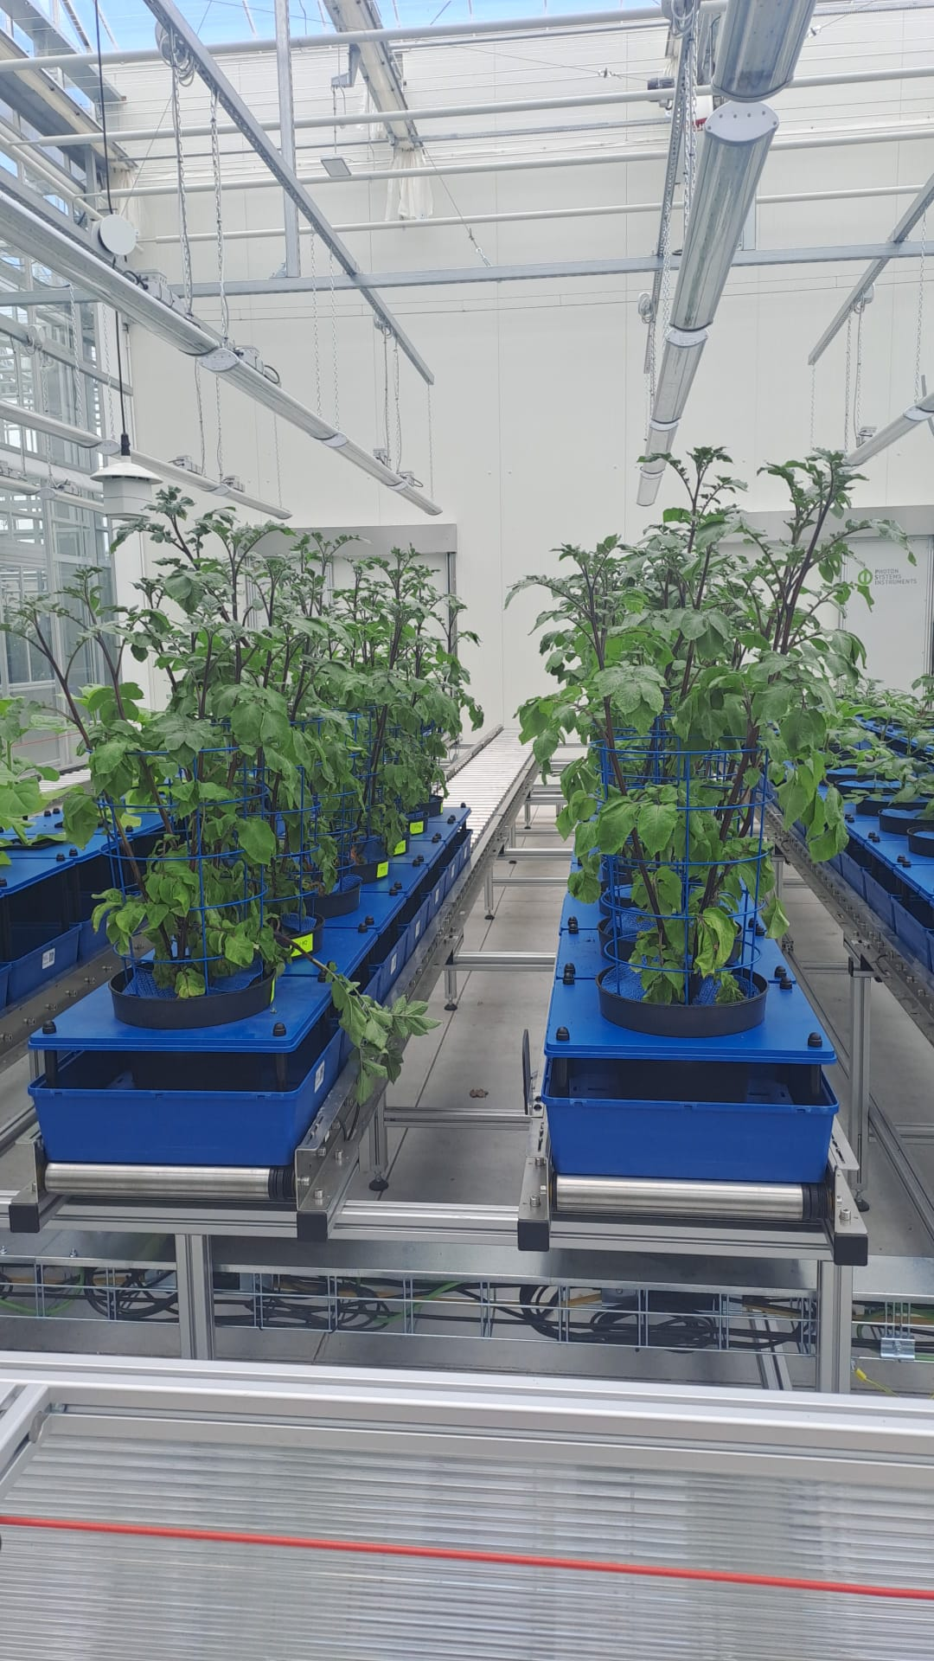

Slide 5
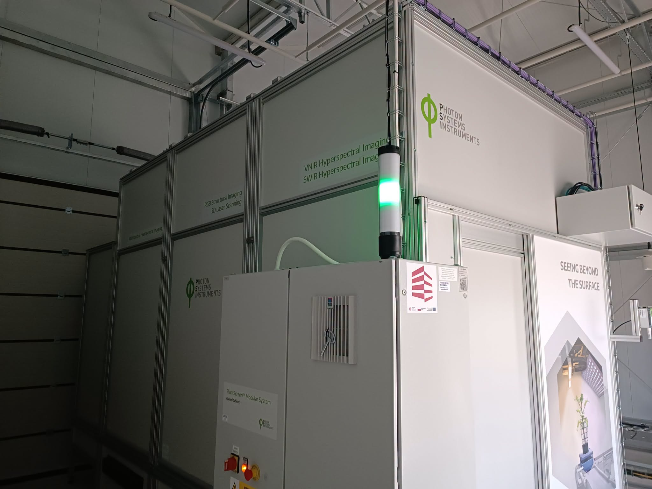

Slide 6
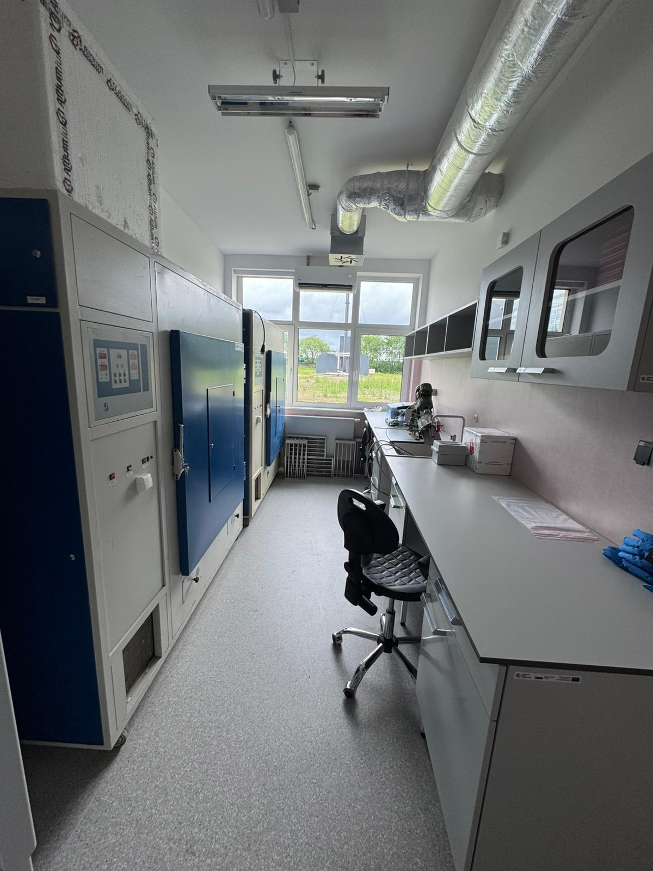
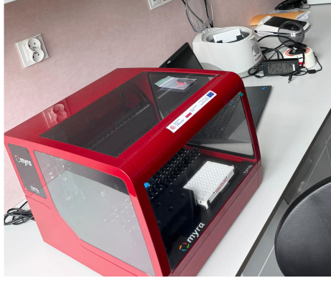
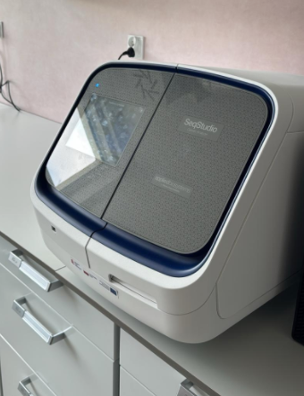
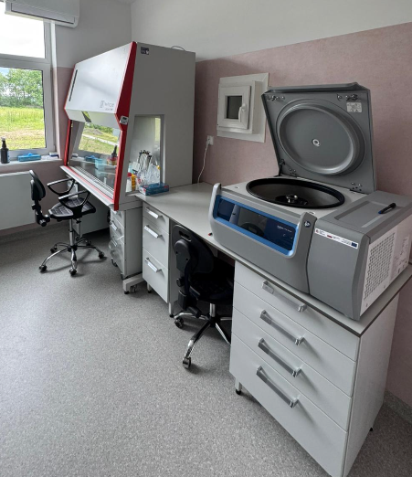
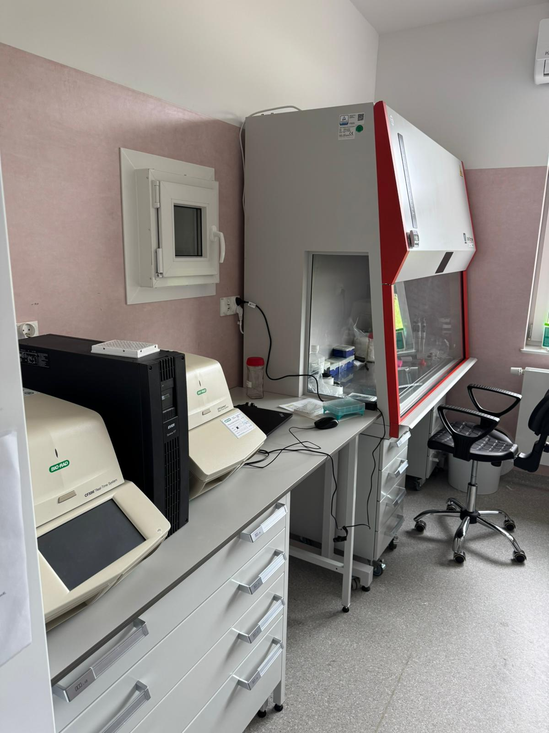
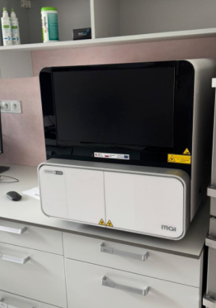
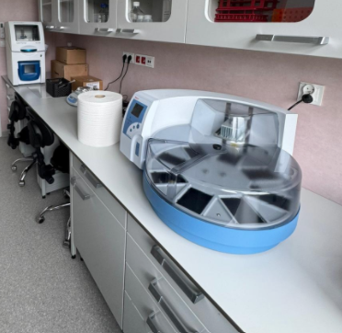

Slide 7
Thank you for your attention.
The Plant Breeding and Acclimatization Institute (IHAR) - National Research Institute
Radzików
05-870 Błonie, Poland
tel. 22 733 45 00
NIP-PL: 5290007029
REGON: 000079480
e-mail: postbox@ihar.edu.pl
www.ihar.edu.pl
Krzysztof Treder
IHAR-PIB
Bonin 3
76-009 Bonin
tel. +48943423031 ext. 207
e-mail: k.treder@ihar.edu.pl

